Slide 1
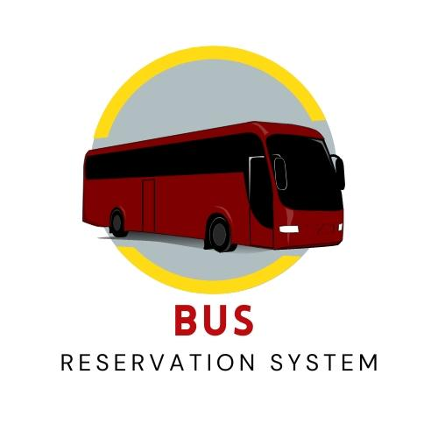
BUILDING BUS RESERVATION SYSTEM.
Student Name:S.Janani. College Name: AMSEC
Student ID: 620221104009. College Code: 6202

Slide 2
Abstract
Brief overview of the bus reservation system, its purpose, and its benefits.
The abstract should provide a concise summary of the bus reservation system, highlighting its purpose, key features, and benefits.
It should give readers a clear understanding of what the project aims to achieve and why it’s important.

Slide 3
Problem Statement:
Identify the challenges or issues faced in traditional bus booking systems that this project aims to address.
A diagram illustrating the shortcomings of traditional bus booking systems, such as long queues, manual ticketing processes, and limited accessibility, could help visualize the challenges faced by users and bus operators.
Explain how these challenges impact both the users and the bus operators.

Slide 4
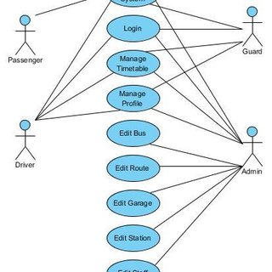
Bus booking System Activity Diagram
Planning
Analysis
Design
Implementation
System

Slide 5
Objectives of study
The main purpose of this study is to implement flexible procedures for booking a bus ticket for any trip made
by Imo Transport Company (ITC). The system is said to be the default system and customers can choose their
own seats. Specifically, the objectives of this project will be to:
i) Provide a web-based bus booking service where a customer can Buy a bus ticket online without the need to line up counter to buy a bus ticket.
ii) Empowering customers to check availability and types of buses online. The customer can check the timing of the entire ITC bus by using system.

Slide 6
iii) Facilitating the payment of bus tickets by obtaining a bank pin after payment various designated banks.
iv) The ability of customers to cancel their booking.
v) User management rights in renewal and cancellation of payment, route and vehicle Records
Research Gaps
According to Kevin (2012) Web-based Bus Reservation and Ticketing System a standard web portal system that
assists bus customers to reserve a seat at a particular bus company at anytime and anywhere and there are a
variety of buses that meet customer needs.

Slide 7
This project, on the part of the bus company, serves as a marketing
strategy and facilitates the proper processing and delivery of travel receipts. The project used software such as
Adobe Photoshop CS4 for image editing, Adobe Dreamweaver CS4 and Notepad ++ as a development tool,
MySQL database, Apache as a web server, mpdf for PDF making and PayPal Sandbox for payment. For advanced
results, it used jQuery, but softwares were adopted for this project, and in recent times have been improved. So,
Adobe Dreamweaver CS6, Adobe Photoshop CS6, MySQL v.5 are will be used for this project.

Slide 8
Study on Electronic Ticketing in Public Transport
The European Metropolitan Transport Authority (EMTA) co-ordinator, Mohamed Mezghani (2008) said EMTA
has established a working group that will work on the issue of electronic ticketing.
The group is mandated to generate information, exchange information and learn from the experience of its members in the field of electronic ticketing.
In its framework, EMTA presented research on electronic public transport tickets under the auspices of the working group and devised specific concepts such as public transport prices, public transport tickets and electric tickets for public transport

Slide 9
Online Transport Booking System
Badariah, (2007) emphasized that the Online Transport Booking System established
at Politeknik Kota Kuala
Terengganu (PKKT) would ensure that users could book online or book their desired travel
companies with the
services offered by the new system. He pointed out that the method and technology
used in the new transport system could also be applied to other workplaces.
A user who wants to use transport must apply for a booking of transport before boarding.
Similarly, after considering the type of plan adopted by Badariah, the project will be built
with the same purpose of introducing customers to Imo Transport Company

Slide 10
He pointed out that the method and technology used in the new transport
system could also be applied to other workplaces. A user who wants to use transport must apply for a booking
of transport before boarding. Similarly, after considering the type of plan adopted by Badariah, the project will
be built with the same purpose of introducing customers to Imo Transport Company and the opportunity to
make reservations in their homes or offices without having to face the challenges of the calculation line before
taking any trip. This project will also enlighten potential buyers and users of the system with the need to
protect the system as it shows many advantages over the old system by providing easy-to-use Graphic User
interface (GUI), pre-board access, etc.

Slide 11
METHODOLOGY
Research Methodology
The research project data collection system is known as the research method. Data can be collected or
conducted a theoretical or practical study for example management research can be considered strategies and
methodology for the implementation and management of change.
The information used in this study was done orally.

Slide 12
Choice of methodology
For any project to be completed, it must go through stages called Development Life Cycles.
System Development Life Cycle (SDLC) is a process of understanding how the Information System (IS) can support business needs, design a system, build and deliver it to users.
The SDLC identifies four phases:
Planning, Analysis, Construction and Implementation In order to develop this project, the approach will be used by the System Structured Analysis and Design Methodology.

Slide 13
Project Overview
Description of the bus reservation system, its main features, and functionalities.
Overview of how the system will benefit both passengers and bus operators.
Discuss how the system facilitates the booking process for passengers, manages bus schedules and availability for operators, and provides administrative tools for system management
Explain how the system improves efficiency, convenience, and accuracy compared to traditional booking methods.

Slide 14
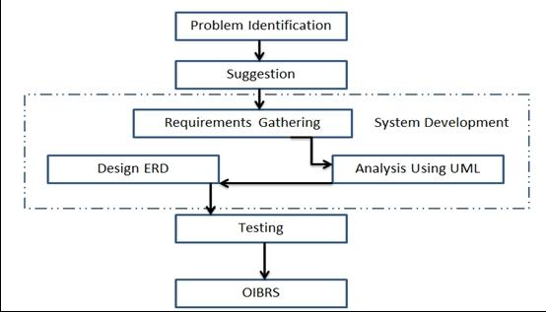
Project Overview

Slide 15
Technology View
Provide an overview of the technology stack used in developing the bus reservation system.
Discuss the programming languages, frameworks, databases, and other technologies employed in building the system.
Explain the architectural design of the system, including the front-end user interface and back-end server components.
Mention any third-party APIs or services integrated into the system, such as payment gateways or mapping services.

Slide 16
Technology view
Technology stack diagram showcasing the various technologies used in the development of the bus reservation system.
This could include front-end frameworks (e.g., React.js), back-end frameworks (e.g., Node.js), databases (e.g., MongoDB), and any third-party APIs or services integrated into the system.
Provide an overview of the technology stack used in developing the bus reservation system.
Discuss the programming languages, frameworks, databases, and other technologies employed in building the system.
Explain the architectural design of the system, including the front-end user interface and back-end server components.

Slide 17
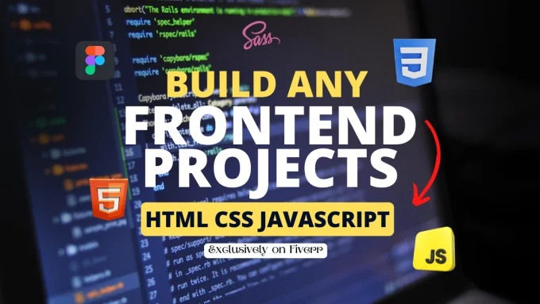

Frontend. Backend. .

Slide 18
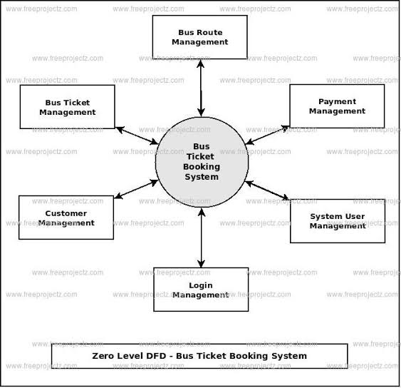
Technology view :

Slide 19
Modeling And results
Describe the data modeling approach used in designing the database schema for the bus reservation system.
Present any performance metrics, testing results, or benchmarks achieved during the development and testing phases.
Discuss any challenges encountered during modeling or implementation and how they were addressed.
Inputs & Output Designs Design to insert a link between the information system and the user. It contains advanced specifications and data processing procedures and those steps are required to incorporate transaction data into a usable data processing form while designing the process involves designing the required results in the form of reports to be provided to users according to needs. Below are some screenshots with the input and output designs of the proposed. system..

Slide 20
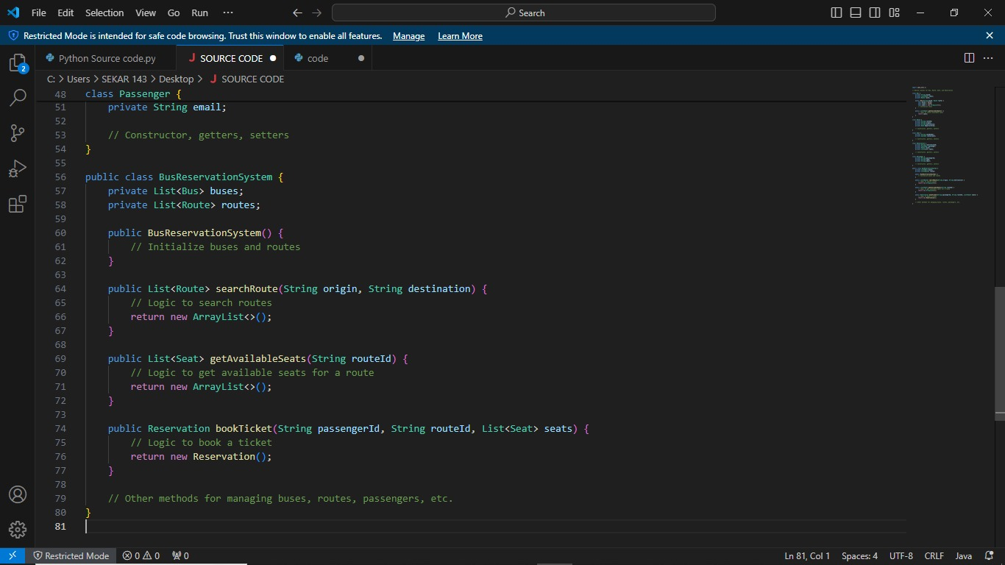
Screen Shot

Slide 21
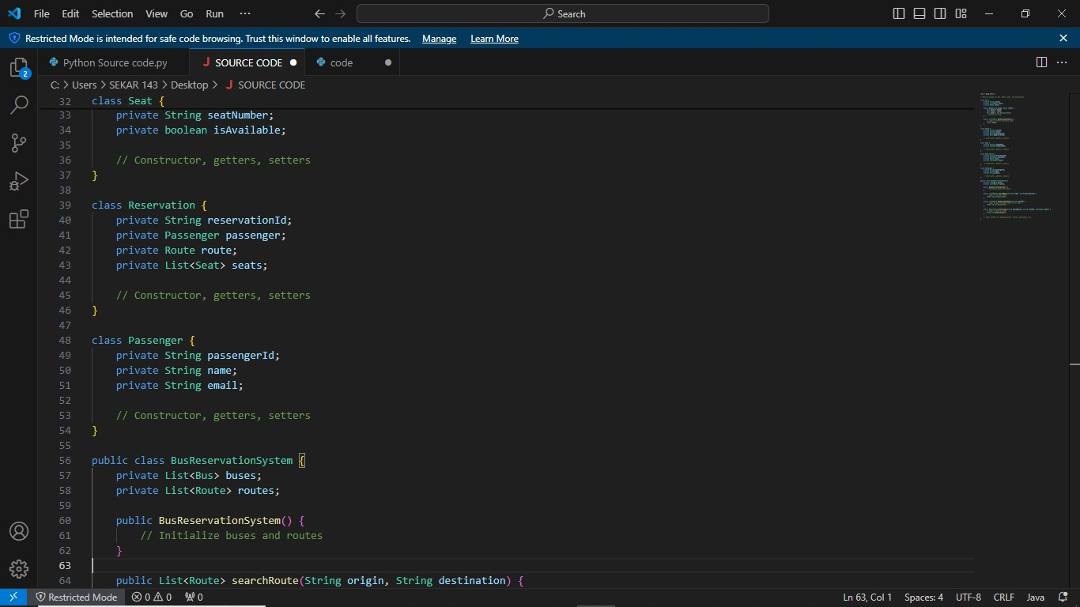

Slide 22
Future Enhancement
Outline potential future enhancements or additional features that could be Implemented to improve the bus reservation system.
Discuss ideas for incorporating new technologies, enhancing user experience, and expanding functionality based on user feedback and industry trends.
Prioritize future enhancements based on their potential impact and feasibility of implementation.

Slide 23
Conclusion
It can be seen that computer applications are very important in every field of human endeavor.
Here with this new system all the information about the customer making a reservation can be obtained by clicking a button, removing some of the difficulties that come with the manual system.

Slide 24
THANK YOU

